Slide 1






THE LINUX SCHEDULER:
A DECADE OF WASTED CORES
Jean-Pierre Lozi
jplozi@unice.fr
Baptiste Lepers
baptiste.lepers@epfl.ch
Fabien Gaud
me@fabiengaud.net
Alexandra Fedorova
Vivien Quéma
sasha@ece.ubc.ca
Justin Funston
jfunston@ece.ubc.ca
vivien.quema@imag.fr
THE LINUX SCHEDULER: A DECADE OF WASTED CORES

Slide 2





INTRODUCTION
Take a machine with a lot of cores (64 in our case)
2/16

Slide 3
INTRODUCTION
Take a machine with a lot of cores (64 in our case)
Run two CPU-intensive processes in two terminals (e.g. R scripts):
R < script.R --nosave & R < script.R --nosave &
2/16

Slide 4
INTRODUCTION
Take a machine with a lot of cores (64 in our case)
Run two CPU-intensive processes in two terminals (e.g. R scripts):
R < script.R --nosave & R < script.R --nosave &
Compile your kernel in a third terminal:
make –j 62 kernel
2/16

Slide 5
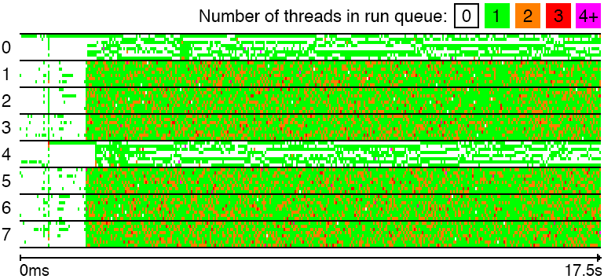
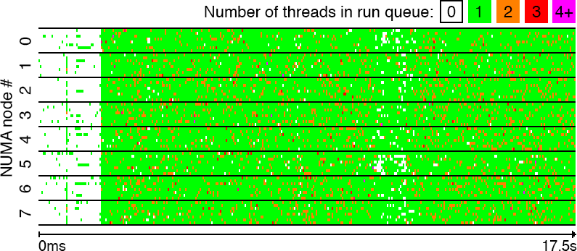
INTRODUCTION
Take a machine with a lot of cores (64 in our case)
Run two CPU-intensive processes in two terminals (e.g. R scripts):
R < script.R --nosave & R < script.R --nosave &
Compile your kernel in a third terminal:
make –j 62 kernel
Here is what might happen:
2/16

Slide 6
INTRODUCTION
Take a machine with a lot of cores (64 in our case)
Run two CPU-intensive processes in two terminals (e.g. R scripts):
R < script.R --nosave & R < script.R --nosave &
Compile your kernel in a third terminal:
make –j 62 kernel
Here is what might happen:
Two NUMA nodes with
many idle cores (white)
2/16

Slide 7
INTRODUCTION
Take a machine with a lot of cores (64 in our case)
Run two CPU-intensive processes in two terminals (e.g. R scripts):
R < script.R --nosave & R < script.R --nosave &
Compile your kernel in a third terminal:
make –j 62 kernel
Here is what might happen:
Two NUMA nodes with
many idle cores (white)
Other NUMA nodes with many overloaded cores (orange, red)
2/16

Slide 8
Performance degradation:
14% for the make process!
INTRODUCTION
Take a machine with a lot of cores (64 in our case)
Run two CPU-intensive processes in two terminals (e.g. R scripts):
R < script.R --nosave & R < script.R --nosave &
Compile your kernel in a third terminal:
make –j 62 kernel
Here is what might happen:
Two NUMA nodes with
many idle cores (white)
Other NUMA nodes with many overloaded cores (orange, red)
2/16

Slide 9
INTRODUCTION
General-purpose schedulers aim to be work-conserving on multicore architectures
3/16

Slide 10
INTRODUCTION
General-purpose schedulers aim to be work-conserving on multicore architectures
Basic invariant: no idle cores if some cores have several threads in their runqueues
Can actually happen, but only in transient situations!
3/16

Slide 11
INTRODUCTION
General-purpose schedulers aim to be work-conserving on multicore architectures
Basic invariant: no idle cores if some cores have several threads in their runqueues
Can actually happen, but only in transient situations!
We found four major bugs that break this invariant in the Linux scheduler (CFS)!
3/16

Slide 12
INTRODUCTION
General-purpose schedulers aim to be work-conserving on multicore architectures
Basic invariant: no idle cores if some cores have several threads in their runqueues
Can actually happen, but only in transient situations!
We found four major bugs that break this invariant in the Linux scheduler (CFS)!
This talk: presentation of the CFS scheduler + issues we found + discussion
3/16

Slide 13

INTRODUCTION
General-purpose schedulers aim to be work-conserving on multicore architectures
Basic invariant: no idle cores if some cores have several threads in their runqueues
Can actually happen, but only in transient situations!
We found four major bugs that break this invariant in the Linux scheduler (CFS)!
This talk: presentation of the CFS scheduler + issues we found + discussion
Disclaimer: this is a motivation paper!
Don’t expect a solved problem ☺
3/16

Slide 14


THE COMPLETELY FAIR SCHEDULER (CFS): CONCEPT
Core 0
Core 1
Core 2
Core 3
4/16

Slide 15
THE COMPLETELY FAIR SCHEDULER (CFS): CONCEPT
One runqueue, threads sorted by runtime
R = 103
R = 82
R = 24
R = 18
R = 12
Core 0
Core 1
Core 2
Core 3
4/16

Slide 16
THE COMPLETELY FAIR SCHEDULER (CFS): CONCEPT
When thread done running
for its timeslice : enqueued again
One runqueue, threads sorted by runtime
R = 112
R = 103
R = 82
R = 24
R = 18
R = 12
Core 0
Core 1
Core 3
Core 2
4/16

Slide 17
THE COMPLETELY FAIR SCHEDULER (CFS): CONCEPT
When thread done running
for its timeslice : enqueued again
One runqueue, threads sorted by runtime
R = 112
R = 103
R = 82
R = 24
Lower niceness = longer timeslice
(tasks allowed to run longer)
R = 18
R = 12
Core 0
Core 1
Core 2 Core 3
4/16

Slide 18
THE COMPLETELY FAIR SCHEDULER (CFS): CONCEPT
When thread done running
for its timeslice : enqueued again
One runqueue, threads sorted by runtime
Cores: next task from runqueue
R = 112
R = 103
R = 82
R = 24
Lower niceness = longer timeslice
(tasks allowed to run longer)
R = 18
R = 12
Core 0
Core 1
Core 2 Core 3
4/16

Slide 19
THE COMPLETELY FAIR SCHEDULER (CFS): CONCEPT
When thread done running
for its timeslice : enqueued again
One runqueue, threads sorted by runtime
Cores: next task from runqueue
R = 112
R = 103
R = 82
R = 24
Lower niceness = longer timeslice
(tasks allowed to run longer)
In practice: cannot work with single runqueue because of contention!
R = 18
R = 12
Core 0
Core 1
Core 2 Core 3
4/16

Slide 20

CFS: IN PRACTICE
One runqueue per core to avoid contention
W=1
W=6
W=1
W=1
W=1
W=1
W=1
Core 0
Core 1
5/16

Slide 21
CFS: IN PRACTICE
One runqueue per core to avoid contention
CFS periodically balances “loads”:
W=1
W=6
W=1
W=1
load(task) = weight¹ x % cpu use²
W=1
W=1
W=1
Core 0
Core 1
5/16

Slide 22
CFS: IN PRACTICE
One runqueue per core to avoid contention
CFS periodically balances “loads”:
W=1
W=6
W=1
W=1
load(task) = weight¹ x % cpu use²
W=1
W=1
W=1
¹ Lower niceness = higher weight
Core 0
Core 1
5/16

Slide 23
CFS: IN PRACTICE
One runqueue per core to avoid contention
CFS periodically balances “loads”:
W=1
W=6
W=1
W=1
load(task) = weight¹ x % cpu use²
W=1
W=1
W=1
Lower niceness = higher weight
Prevent high-priority thread from taking whole CPU just to sleep
Core 0
Core 1
5/16

Slide 24

CFS: IN PRACTICE
One runqueue per core to avoid contention
CFS periodically balances “loads”:
W=1
W=6
W=1
W=1
load(task) = weight¹ x % cpu use²
W=1
W=1
W=1
Lower niceness = higher weight
Prevent high-priority thread from taking whole CPU just to sleep
Core 0
Core 1
5/16

Slide 25
CFS: IN PRACTICE
One runqueue per core to avoid contention
CFS periodically balances “loads”:
W=1
W=6
W=1
W=1
load(task) = weight¹ x % cpu use²
W=1
W=1
W=1
Lower niceness = higher weight
Prevent high-priority thread from taking whole CPU just to sleep
Core 0
Core 1
Since there can be many cores: hierarchical approach!
5/16

Slide 26
CFS: BALANCING THE LOAD
L=2000 L=3000
L=6000
L=1000
L=1000
L=1000
L=1000
L=3000
L=1000
L=1000
L=1000
L=1000
L=1000
L=1000
Core 0
Core 1
Core 2
Core 3
6/16

Slide 27
CFS: BALANCING THE LOAD
L=2000 L=3000
L=6000 L=1000
L=1000
L=1000
L=1000
L=3000
L=1000
L=1000
L=1000
L=1000
L=1000
L=1000
Core 0
Core 1
Core 2
Core 3
6/16

Slide 28
CFS: BALANCING THE LOAD
L=2000 L=3000
L=6000
L=1000
L=1000
L=1000
L=1000
L=3000
L=1000
L=1000
L=1000
L=1000
L=1000
L=1000
Core 0
Core 1
Core 2
Core 3
6/16

Slide 29
CFS: BALANCING THE LOAD
L=2000 L=3000
L=6000
L=1000
Balanced!
L=1000
L=1000
L=1000
L=3000
L=1000
L=1000
L=1000
L=1000
L=1000
L=1000
Core 0
Core 1
Core 2
Core 3
6/16

Slide 30
CFS: BALANCING THE LOAD
L=2000 L=3000
L=6000 L=1000
Balanced!
L=1000
L=1000
L=1000
L=3000
L=1000
L=1000
L=1000
L=1000
L=1000
L=1000
Core 2
Core 3
Core 0
Core 1
6/16

Slide 31
CFS: BALANCING THE LOAD
L=2000 L=3000
L=4000
L=3000
Balanced!
Balanced!
L=1000
L=1000
L=1000
L=1000
L=3000
L=1000
L=1000
L=1000
L=1000
L=1000
Core 0
Core 1
Core 2
Core 3
6/16

Slide 32
CFS: BALANCING THE LOAD
AVG(L)=2500
L=2000 L=3000
AVG(L)=3500
L=4000 L=3000
L=1000
L=1000
L=1000
L=1000
L=3000
L=1000
L=1000
L=1000
L=1000
L=1000
Core 0
Core 1
Core 2
Core 3
6/16

Slide 33
CFS: BALANCING THE LOAD
AVG(L)=3000
L=3000 L=3000
AVG(L)=3000
L=3000 L=3000
L=1000
L=1000
L=1000
L=1000
L=3000
L=1000
L=1000
L=1000
L=1000
L=1000
Core 0
Core 1
Core 2
Core 3
6/16

Slide 34
CFS: BALANCING THE LOAD
AVG(L)=3000
AVG(L)=3000
L=3000 L=3000
L=3000
L=3000
Balanced!
L=1000
L=1000
L=1000
L=1000
L=3000
L=1000
L=1000
L=1000
L=1000
L=1000
Core 0
Core 1
Core 2
Core 3
6/16

Slide 35
CFS: BALANCING THE LOAD
Load calculations are actually more complicated, use more heuristics
7/16

Slide 36
CFS: BALANCING THE LOAD
Load calculations are actually more complicated, use more heuristics
One of them aims to increase fairness between “sessions”
7/16

Slide 37
CFS: BALANCING THE LOAD
Load calculations are actually more complicated, use more heuristics
One of them aims to increase fairness between “sessions”
Idea: ensure a tty cannot eat up all resources by spawning many threads
7/16

Slide 38
CFS: BALANCING THE LOAD
Load calculations are actually more complicated, use more heuristics
One of them aims to increase fairness between “sessions”
Idea: ensure a tty cannot eat up all resources by spawning many threads
L=1000
Session (tty) 1
L=1000
L=1000
L=1000
L=1000
Session (tty) 2
7/16

Slide 39
CFS: BALANCING THE LOAD
Load calculations are actually more complicated, use more heuristics
One of them aims to increase fairness between “sessions”
Idea: ensure a tty cannot eat up all resources by spawning many threads
L=1000
Session (tty) 1
L=1000
L=1000
L=1000
L=1000
L=1000
L=1000
L=1000
Session (tty) 2
L=1000
L=1000
7/16

Slide 40


CFS: BALANCING THE LOAD
Load calculations are actually more complicated, use more heuristics
One of them aims to increase fairness between “sessions”
Idea: ensure a tty cannot eat up all resources by spawning many threads
50% of a core
L=1000
Session (tty) 1
L=1000
L=1000
L=1000
L=1000
L=1000
150%
L=1000
L=1000
Session (tty) 2
L=1000
L=1000
7/16

Slide 41



CFS: BALANCING THE LOAD
Load calculations are actually more complicated, use more heuristics
One of them aims to increase fairness between “sessions”
Idea: ensure a tty cannot eat up all resources by spawning many threads
50% of a core
L=1000
Session (tty) 1
L=1000
L=1000
L=1000
L=1000
L=1000
150%
L=1000
L=1000
Session (tty) 2
L=1000
L=1000
7/16

Slide 42
CFS: BALANCING THE LOAD
Load calculations are actually more complicated, use more heuristics
One of them aims to increase fairness between “sessions”
Solution: divide the load of a task by the number of threads in its tty!
7/16

Slide 43
CFS: BALANCING THE LOAD
Load calculations are actually more complicated, use more heuristics
One of them aims to increase fairness between “sessions”
Solution: divide the load of a task by the number of threads in its tty!
L=1000
Session (tty) 1
L=250
L=250
L=250
L=250
Session (tty) 2
7/16

Slide 44
CFS: BALANCING THE LOAD
Load calculations are actually more complicated, use more heuristics
One of them aims to increase fairness between “sessions”
Solution: divide the load of a task by the number of threads in its tty!
L=1000
Session (tty) 1
L=1000
L=250
L=250
L=250
L=250
L=250
L=250
L=250
Session (tty) 2
L=250
7/16

Slide 45

CFS: BALANCING THE LOAD
Load calculations are actually more complicated, use more heuristics
One of them aims to increase fairness between “sessions”
Solution: divide the load of a task by the number of threads in its tty!
100% of a core
L=1000
Session (tty) 1
L=1000
L=250
L=250
L=250
100% of a core
L=250
L=250
L=250
L=250
Session (tty) 2
L=250
7/16

Slide 46






CFS: BALANCING THE LOAD
Load calculations are actually more complicated, use more heuristics
One of them aims to increase fairness between “sessions”
Solution: divide the load of a task by the number of threads in its tty!
100% of a core
L=1000
Session (tty) 1
L=250
L=250
L=250
100% of a core
L=250
L=250
L=250
L=1000
L=250
Session (tty) 2
L=250
7/16

Slide 47
CFS: BALANCING THE LOAD: BUG #1
L=0 L=1000
L=500 L=500
Session (tty) 1
Session (tty) 2
Session (tty) 2
L=1000
L=250
L=250
L=250
L=250
Core 0
Core 1
Core 2
Core 3
8/16

Slide 48
CFS: BALANCING THE LOAD: BUG #1
L=0 L=1000
L=500 L=500
L=1000
L=250
L=250
L=250
L=250
Core 0
Core 1
Core 2
Core 3
8/16

Slide 49
CFS: BALANCING THE LOAD: BUG #1
L=0 L=1000 L=500
L=500
L=1000
L=250
L=250
L=250
L=250
Core 0
Core 1 Core 2
Core 3
8/16

Slide 50
CFS: BALANCING THE LOAD: BUG #1
L=0 L=1000 L=500
L=500
Balanced!
L=1000
L=250
L=250
L=250
L=250
Core 0
Core 1 Core 2
Core 3
8/16

Slide 51
CFS: BALANCING THE LOAD: BUG #1
L=0 L=1000
L=500 L=500
Balanced!
L=1000
L=250
L=250
L=250
L=250
Core 2
Core 3
Core 0
Core 1
8/16

Slide 52
CFS: BALANCING THE LOAD: BUG #1
L=0 L=1000 L=500 L=500
Balanced! Balanced!
L=1000
L=250
L=250
L=250
L=250
Core 2
Core 3
Core 0
Core 1
8/16

Slide 53
CFS: BALANCING THE LOAD: BUG #1
AVG(L)=500 AVG(L)=500
L=0 L=1000
L=500 L=500
Balanced!
Balanced!
L=1000
L=250
L=250
L=250
L=250
Core 0
Core 1
Core 2
Core 3
8/16

Slide 54
CFS: BALANCING THE LOAD: BUG #1
AVG(L)=500 AVG(L)=500
L=0
L=1000
Balanced!
L=500 L=500
Balanced!
Balanced!
L=1000
L=250
L=250
L=250
L=250
Core 0
Core 1
Core 2
Core 3
8/16

Slide 55
CFS: BALANCING THE LOAD: BUG #1
AVG(L)=500 AVG(L)=500
L=0
L=1000
Balanced!
L=500 L=500
Balanced!
Balanced!
L=1000
!!!
L=250
L=250
L=250
L=250
Core 0
Core 1
Core 2
Core 3
8/16

Slide 56






CFS: BALANCING THE LOAD: BUG #1
AVG(L)=500 AVG(L)=500
L=0
L=1000
Balanced!
L=500 L=500
Balanced!
Balanced!
L=1000
!!!
L=250
L=250
L=250
L=250
Core 0
Core 1
Core 2
Core 3
8/16

Slide 57
CFS: BALANCING THE LOAD: BUG #1
This was our bug!
9/16

Slide 58
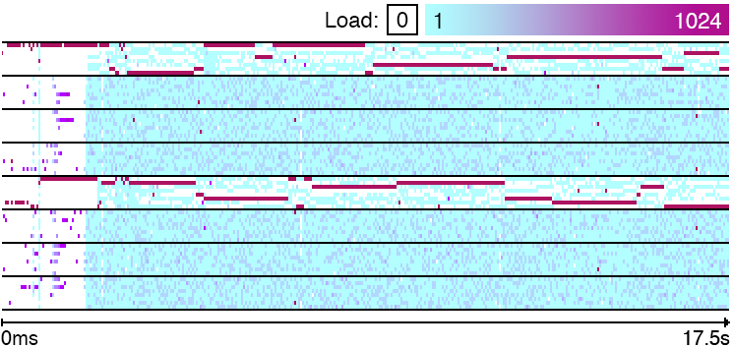
CFS: BALANCING THE LOAD: BUG #1
This was our bug!
9/16

Slide 59
CFS: BALANCING THE LOAD: BUG #1
This was our bug!
Load 1 = avg(R thread with high load + a few make threads with low load)
9/16

Slide 60
CFS: BALANCING THE LOAD: BUG #1
This was our bug!
Load 1 = avg(R thread with high load + a few make threads with low load)
Load 2 = avg(many make threads with low load)
9/16

Slide 61
CFS: BALANCING THE LOAD: BUG #1
This was our bug!
Load 1 = avg(R thread with high load + a few make threads with low load)
Load 2 = avg(many make threads with low load)
Load 1 = Load 2 : the scheduler thinks the load is balanced!
9/16

Slide 62
MORE BUGS: THE HIERARCHY
We saw load balancing hierarchical: cores, pairs of cores, dies, CPUs, NUMA nodes...
10/16

Slide 63
MORE BUGS: THE HIERARCHY
We saw load balancing hierarchical: cores, pairs of cores, dies, CPUs, NUMA nodes...
Bug #2: on complex machines, hierarchy built incorrectly!
10/16

Slide 64
MORE BUGS: THE HIERARCHY
We saw load balancing hierarchical: cores, pairs of cores, dies, CPUs, NUMA nodes...
Bug #2: on complex machines, hierarchy built incorrectly!
Intuition: at the last level, groups in the hierarchy “not disjoint”
10/16

Slide 65
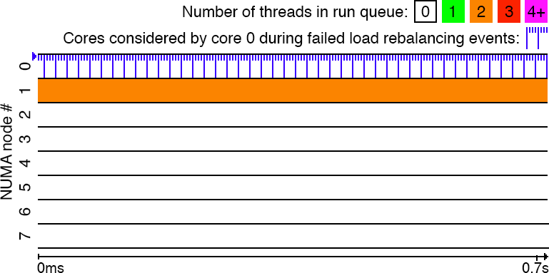
MORE BUGS: THE HIERARCHY
We saw load balancing hierarchical: cores, pairs of cores, dies, CPUs, NUMA nodes...
Bug #2: on complex machines, hierarchy built incorrectly!
Intuition: at the last level, groups in the hierarchy “not disjoint”
Can break load balancing: whole application running on a single node!
10/16

Slide 66
MORE BUGS: THE HIERARCHY
We saw load balancing hierarchical: cores, pairs of cores, dies, CPUs, NUMA nodes...
Bug #2: on complex machines, hierarchy built incorrectly!
Intuition: at the last level, groups in the hierarchy “not disjoint”
Can break load balancing: whole application running on a single node!
Bug #3: disabling/reenabling a core breaks the hierarchy completely
10/16

Slide 67
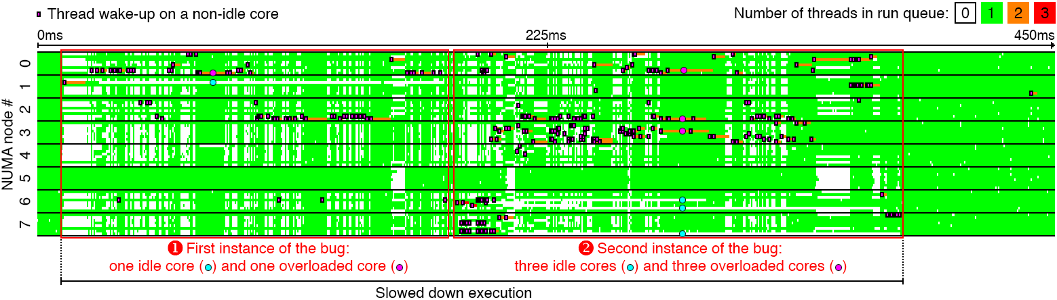
MORE BUGS: WAKEUPS
Bug #4: slow phases with idle cores with popular commercial database + TPC-H
Bug: many idle cores!
THE LINUX SCHEDULER: A DECADE OF WASTED CORES
11/16

Slide 68
MORE BUGS: WAKEUPS
Bug #4: slow phases with idle cores with popular commercial database + TPC-H
In addition to periodic load balancing, threads pick where they wake up
Bug: many idle cores!
THE LINUX SCHEDULER: A DECADE OF WASTED CORES
11/16

Slide 69
MORE BUGS: WAKEUPS
Bug #4: slow phases with idle cores with popular commercial database + TPC-H
In addition to periodic load balancing, threads pick where they wake up
Only local CPU cores considered for wakeup due to locality “optimization”
Bug: many idle cores!
THE LINUX SCHEDULER: A DECADE OF WASTED CORES
11/16

Slide 70
MORE BUGS: WAKEUPS
Bug #4: slow phases with idle cores with popular commercial database + TPC-H
In addition to periodic load balancing, threads pick where they wake up
Only local CPU cores considered for wakeup due to locality “optimization”
Intuition: periodic load balancing global, wakeup balancing local
Bug: many idle cores!
THE LINUX SCHEDULER: A DECADE OF WASTED CORES
11/16

Slide 71
MORE BUGS: WAKEUPS
Bug #4: slow phases with idle cores with popular commercial database + TPC-H
In addition to periodic load balancing, threads pick where they wake up
Only local CPU cores considered for wakeup due to locality “optimization”
Intuition: periodic load balancing global, wakeup balancing local
One makes mistakes the other cannot fix!
Bug: many idle cores!
THE LINUX SCHEDULER: A DECADE OF WASTED CORES
11/16

Slide 72
Performance degradation: 13-24%!
MORE BUGS: WAKEUPS
Bug #4: slow phases with idle cores with popular commercial database + TPC-H
In addition to periodic load balancing, threads pick where they wake up
Only local CPU cores considered for wakeup due to locality “optimization”
Intuition: periodic load balancing global, wakeup balancing local
One makes mistakes the other cannot fix!
Bug: many idle cores!
THE LINUX SCHEDULER: A DECADE OF WASTED CORES
11/16

Slide 73
DISCUSSION: HOW DID WE COME TO THIS?
Scheduling (as in dividing CPU cycles among theads) often thought to be a solved problem
12/16

Slide 74
DISCUSSION: HOW DID WE COME TO THIS?
Scheduling (as in dividing CPU cycles among theads) often thought to be a solved problem
To recap, on Linux, CFS works like this:
It periodically balances, using a metric named load,
12/16

Slide 75
DISCUSSION: HOW DID WE COME TO THIS?
Scheduling (as in dividing CPU cycles among theads) often thought to be a solved problem
To recap, on Linux, CFS works like this:
It periodically balances, using a metric named load,
threads among groups of cores in a hierarchy.
12/16

Slide 76
DISCUSSION: HOW DID WE COME TO THIS?
Scheduling (as in dividing CPU cycles among theads) often thought to be a solved problem
To recap, on Linux, CFS works like this:
It periodically balances, using a metric named load,
threads among groups of cores in a hierarchy.
In addition to this, threads balance the load by selecting core where to wake up.
12/16

Slide 77
DISCUSSION: HOW DID WE COME TO THIS?
Scheduling (as in dividing CPU cycles among theads) often thought to be a solved problem
To recap, on Linux, CFS works like this:
It periodically balances, using a metric named load,
↑ Fundamental issue here... appeared with tty-balancing heuristic for multithreaded apps
threads among groups of cores in a hierarchy.
In addition to this, threads balance the load by selecting core where to wake up.
12/16

Slide 78
DISCUSSION: HOW DID WE COME TO THIS?
Scheduling (as in dividing CPU cycles among theads) often thought to be a solved problem
To recap, on Linux, CFS works like this:
It periodically balances, using a metric named load,
↑ Fundamental issue here... appeared with tty-balancing heuristic for multithreaded apps
threads among groups of cores in a hierarchy.
↑ Fundamental issue here... added with support of complex NUMA hierarchies
In addition to this, threads balance the load by selecting core where to wake up.
12/16

Slide 79
DISCUSSION: HOW DID WE COME TO THIS?
Scheduling (as in dividing CPU cycles among theads) often thought to be a solved problem
To recap, on Linux, CFS works like this:
It periodically balances, using a metric named load,
↑ Fundamental issue here... appeared with tty-balancing heuristic for multithreaded apps
threads among groups of cores in a hierarchy.
↑ Fundamental issue here... added with support of complex NUMA hierarchies
In addition to this, threads balance the load by selecting core where to wake up.
↑ Fundamental issue here... added with locality optimization for multicore architectures
12/16

Slide 80
DISCUSSION: HOW DID WE COME TO THIS?
Scheduling (as in dividing CPU cycles among theads) often thought to be a solved problem
To recap, on Linux, CFS works like this:
It periodically balances, using a metric named load,
↑ Fundamental issue here... appeared with tty-balancing heuristic for multithreaded apps
threads among groups of cores in a hierarchy.
↑ Fundamental issue here... added with support of complex NUMA hierarchies
In addition to this, threads balance the load by selecting core where to wake up.
↑ Fundamental issue here... added with locality optimization for multicore architectures
CFS was simple...
then became complex/broken when needed to support new hardware/uses!
12/16

Slide 81
DISCUSSION: WHERE DO WE GO FROM HERE?
Linux scheduler keeps evolving, different algorithms, new heuristics...
Hardware evolves fast, won’t get any better!
13/16

Slide 82
DISCUSSION: WHERE DO WE GO FROM HERE?
Linux scheduler keeps evolving, different algorithms, new heuristics...
Hardware evolves fast, won’t get any better!
We *need* a *safe* way to keep up with future hardware/uses!
13/16

Slide 83
DISCUSSION: WHERE DO WE GO FROM HERE?
Linux scheduler keeps evolving, different algorithms, new heuristics...
Hardware evolves fast, won’t get any better!
We *need* a *safe* way to keep up with future hardware/uses!
Code testing
No clear fault (no crash, no deadlock, etc.), existing tools don’t target these bugs
13/16

Slide 84
DISCUSSION: WHERE DO WE GO FROM HERE?
Linux scheduler keeps evolving, different algorithms, new heuristics...
Hardware evolves fast, won’t get any better!
We *need* a *safe* way to keep up with future hardware/uses!
Code testing
No clear fault (no crash, no deadlock, etc.), existing tools don’t target these bugs
Performance regression
Usually done with 1 app on a machine to avoid interactions: insufficient coverage
13/16

Slide 85
DISCUSSION: WHERE DO WE GO FROM HERE?
Linux scheduler keeps evolving, different algorithms, new heuristics...
Hardware evolves fast, won’t get any better!
We *need* a *safe* way to keep up with future hardware/uses!
Code testing
No clear fault (no crash, no deadlock, etc.), existing tools don’t target these bugs
Performance regression
Usually done with 1 app on a machine to avoid interactions: insufficient coverage
Model checking, formal proofs
Complex, parallel code: so far, nobody knows how to do it...
13/16

Slide 86
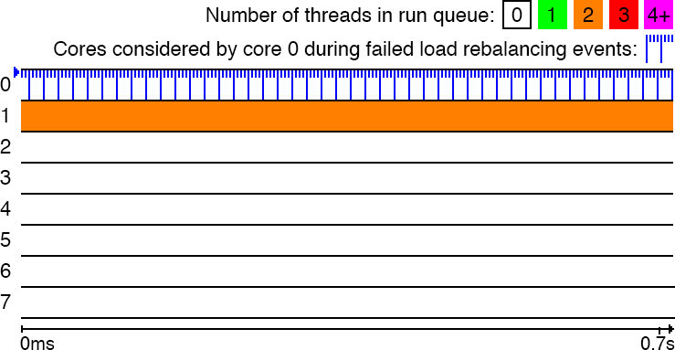
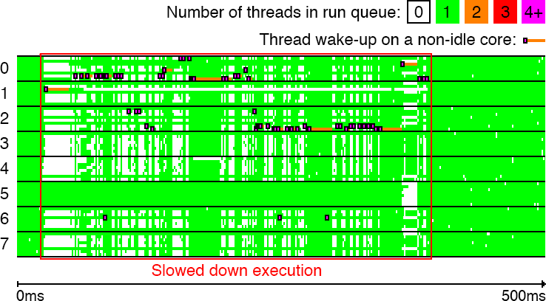
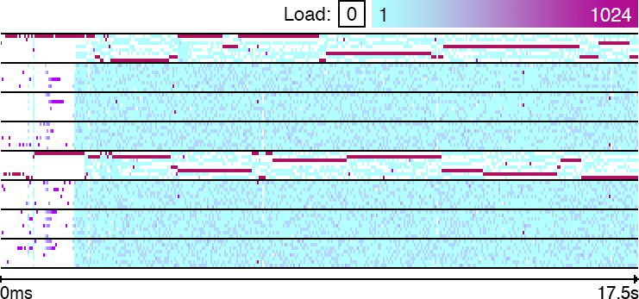
DISCUSSION: WHERE DO WE GO FROM HERE?
What worked for us: sanity checker detects invariant violations to find bugs
14/16

Slide 87
DISCUSSION: WHERE DO WE GO FROM HERE?
What worked for us: sanity checker detects invariant violations to find bugs
Idea: detect suspicious situations, monitor them and produce report if they last
14/16

Slide 88
DISCUSSION: WHERE DO WE GO FROM HERE?
What worked for us: sanity checker detects invariant violations to find bugs
Idea: detect suspicious situations, monitor them and produce report if they last
All bugs presented here detected with sanity checker!
14/16

Slide 89
DISCUSSION: WHERE DO WE GO FROM HERE?
What worked for us: sanity checker detects invariant violations to find bugs
Idea: detect suspicious situations, monitor them and produce report if they last
All bugs presented here detected with sanity checker!
Our experience: exact traces are *necessary* to understand complex scheduling problems
14/16

Slide 90
DISCUSSION: WHERE DO WE GO FROM HERE?
What worked for us: sanity checker detects invariant violations to find bugs
Idea: detect suspicious situations, monitor them and produce report if they last
All bugs presented here detected with sanity checker!
Our experience: exact traces are *necessary* to understand complex scheduling problems
Custom visual tool show all scheduling events / migrations / considered cores / load...
14/16

Slide 91
DISCUSSION: FIXING THE SCHEDULER POSSIBLE?
Basic fixes for the bugs we analyzed:
Bug #1: minimum load instead of average (may be less stable!)
Bugs #2-#3 : building the hierarchy differently (seems to always work!)
Bug #4: wake up on cores idle for longest time (may be bad for energy!)
15/16

Slide 92
DISCUSSION: FIXING THE SCHEDULER POSSIBLE?
Basic fixes for the bugs we analyzed:
Bug #1: minimum load instead of average (may be less stable!)
Bugs #2-#3 : building the hierarchy differently (seems to always work!)
Bug #4: wake up on cores idle for longest time (may be bad for energy!)
Fixes not perfect, hard to ensure they never worsen performance
Linux scheduler too complex, many competing heuristics added empirically!
Hard to guess the effect of one change...
15/16

Slide 93
DISCUSSION: FIXING THE SCHEDULER POSSIBLE?
Basic fixes for the bugs we analyzed:
Bug #1: minimum load instead of average (may be less stable!)
Bugs #2-#3 : building the hierarchy differently (seems to always work!)
Bug #4: wake up on cores idle for longest time (may be bad for energy!)
Fixes not perfect, hard to ensure they never worsen performance
Linux scheduler too complex, many competing heuristics added empirically!
Hard to guess the effect of one change...
Efficient redesign of the scheduler possible?
We envision scheduler with *isolated* modules each trying to optimize one variable...
15/16

Slide 94
DISCUSSION: FIXING THE SCHEDULER POSSIBLE?
Basic fixes for the bugs we analyzed:
Bug #1: minimum load instead of average (may be less stable!)
Bugs #2-#3 : building the hierarchy differently (seems to always work!)
Bug #4: wake up on cores idle for longest time (may be bad for energy!)
Fixes not perfect, hard to ensure they never worsen performance
Linux scheduler too complex, many competing heuristics added empirically!
Hard to guess the effect of one change...
Efficient redesign of the scheduler possible?
We envision scheduler with *isolated* modules each trying to optimize one variable...
How do you make them all work together? Complex, open problem!
15/16

Slide 95
CONCLUSION
Scheduling (as in dividing CPU cycles among theads) often thought to be a solved problem
16/16

Slide 96
CONCLUSION
Scheduling (as in dividing CPU cycles among theads) often thought to be a solved problem
Analysis: fundamental issues (added incrementally), even basic invariant violated!
16/16

Slide 97
CONCLUSION
Scheduling (as in dividing CPU cycles among theads) often thought to be a solved problem
Analysis: fundamental issues (added incrementally), even basic invariant violated!
Proposed pragmatic detection approach (sanity checker + traces): helpful
16/16

Slide 98
CONCLUSION
Scheduling (as in dividing CPU cycles among theads) often thought to be a solved problem
Analysis: fundamental issues (added incrementally), even basic invariant violated!
Proposed pragmatic detection approach (sanity checker + traces): helpful
Proposed fixes: not always satisfactory
16/16

Slide 99
CONCLUSION
Scheduling (as in dividing CPU cycles among theads) often thought to be a solved problem
Analysis: fundamental issues (added incrementally), even basic invariant violated!
Proposed pragmatic detection approach (sanity checker + traces): helpful
Proposed fixes: not always satisfactory
Open problem: how do we ensure the scheduler works/evolves correctly ?
New design? New techniques involving testing/performance regression/proofs/...?
16/16

Slide 100
CONCLUSION
Scheduling (as in dividing CPU cycles among theads) often thought to be a solved problem
Analysis: fundamental issues (added incrementally), even basic invariant violated!
Proposed pragmatic detection approach (sanity checker + traces): helpful
Proposed fixes: not always satisfactory
Open problem: how do we ensure the scheduler works/evolves correctly ?
New design? New techniques involving testing/performance regression/proofs/...?
Your next paper ☺
16/16

